Slide 1
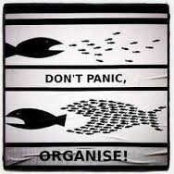
“It always seems impossible until it is done.”

Slide 2

Organising your revision
“You don’t need more time….. You just need to decide.”
Seth Godin

Slide 3
Core principles
Habit stacking
Realistic plan
Resources
Plan, review, re-do
What’s stopping us?
Worry
Not knowing what you have to do
Looking at the longer term

Slide 4
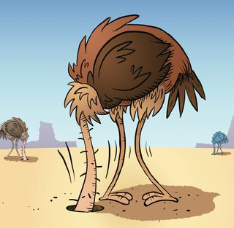
Habit Stacking

Slide 5
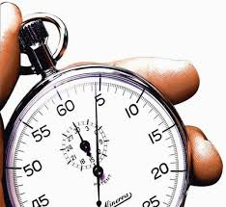
Habit Stacking

Slide 6

Habit Stacking

Slide 7
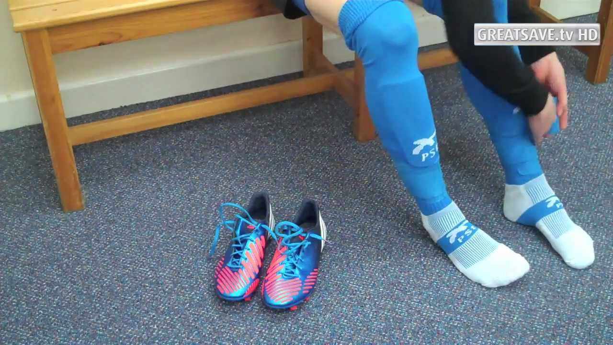
Habit Stacking

Slide 8

Habit Stacking

Slide 9
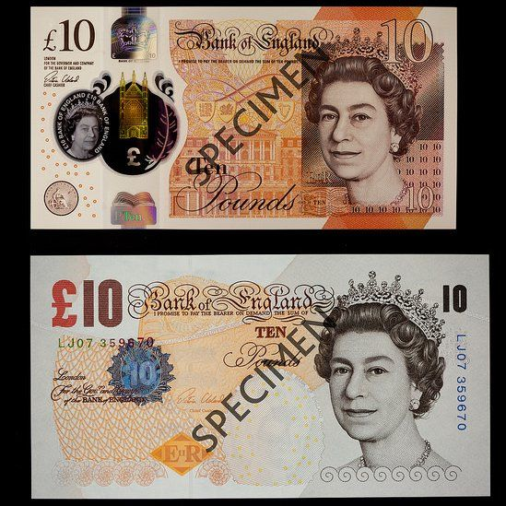
Time to consider how to build your plan
Cognitive Load challenge
Diary – how to do
Break up big topic ideas – try not to ‘do’ Maths. Challenge yourself to relearn ‘Trigonometry.’
< Click for answers >
Activity

Slide 10
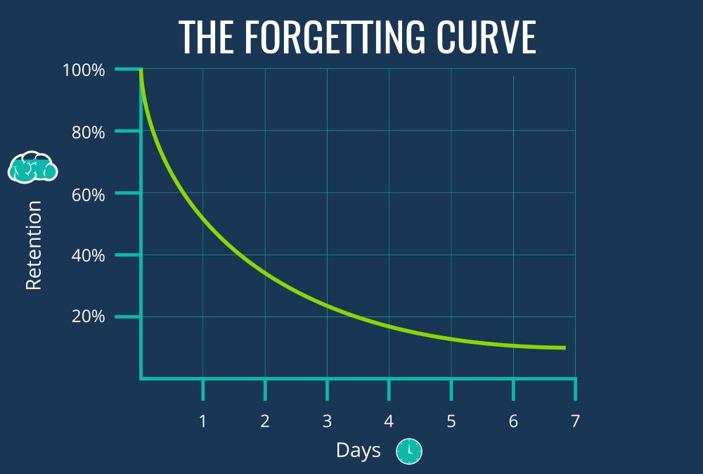

Slide 11
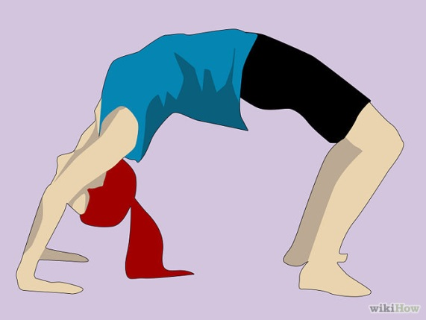

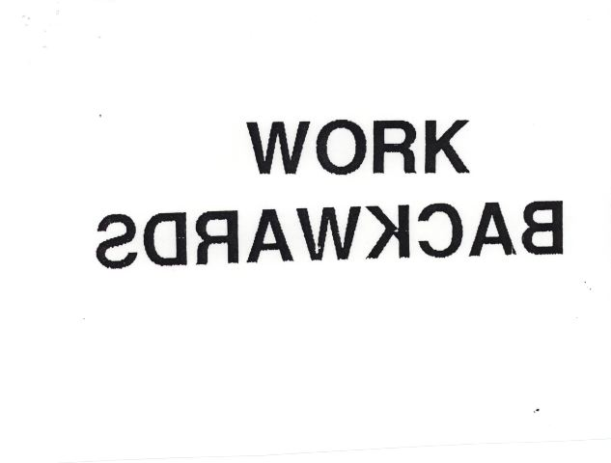


Realistic plan

Slide 12
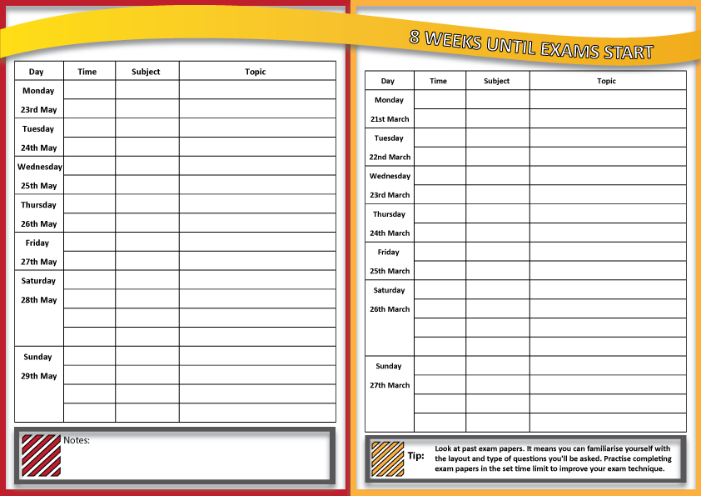
Have 10 exam subjects
So I will spend 2 hours a night on 2 subjects
I will have Friday off
That is four nights of revision
Sunday will be my follow up day
30 + 30
Physics
Electrostatics - uses
Physics
Check from the syllabus what I don’t know
Run through some cards
Attempt a past paper question
Tick another section off
Test again on Sunday

Slide 13
Do
Be careful not to…
Give yourself a follow up day
Habit stack
Be specific (what specific topic in a subject)
Repeat past papers more than once
Split revision: knowledge / past papers
Spend so long making a revision timetable you don’t revise
Be unrealistic with your time
Muddle through
Leave it until the last minute
Want it to be perfect

Slide 14

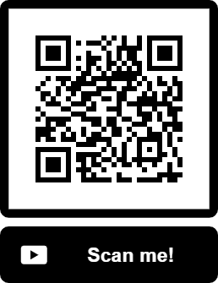
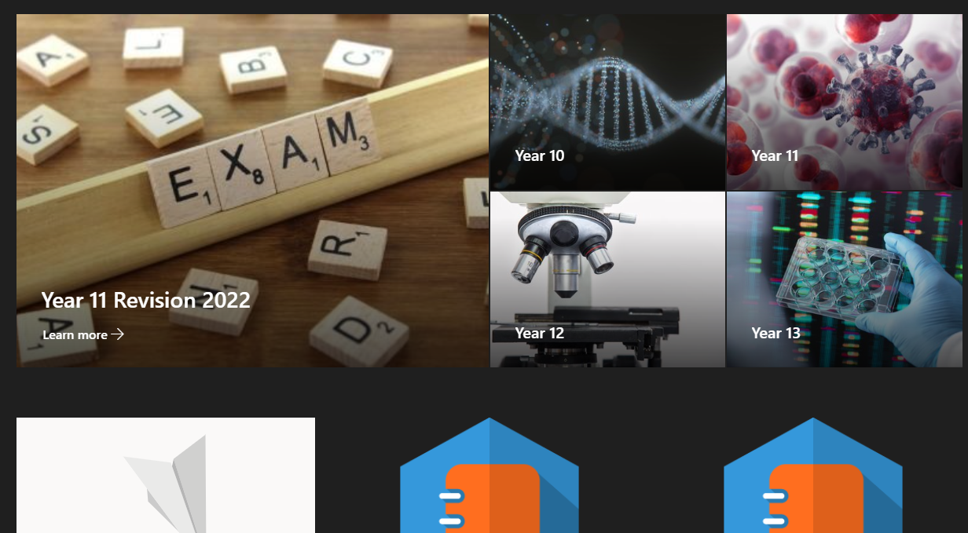
Resources
Access all websites
Access course materials
Also access the seneca

Slide 15
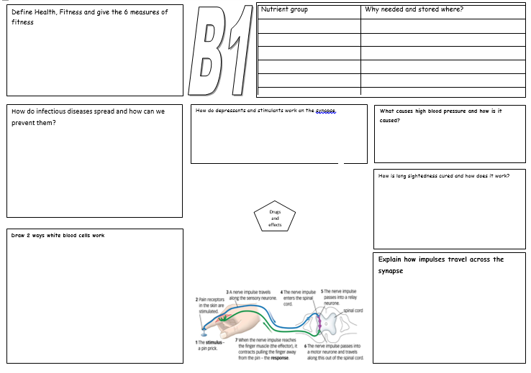
A3 sheets

Slide 16

Q/A flaps
Method:
Key questions cut into flaps and stuck into a revision book.
Fold over the questions that you get right / fold over the questions you get wrong.
Why they work:
They are kept together – you focus on the questions you get wrong.

Slide 17
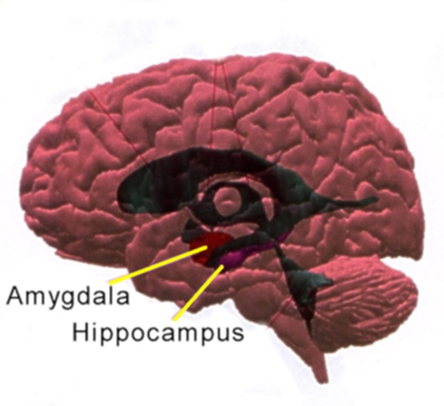
Tickling the amygdala
Resources
Diamond task
Have a look at some strategies.
What would suit you?
*

Slide 18
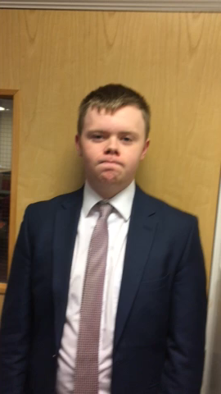
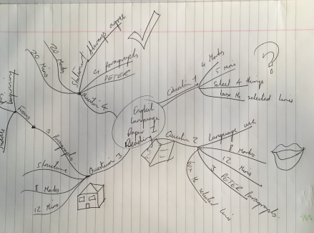
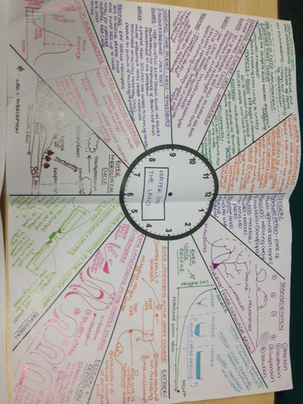
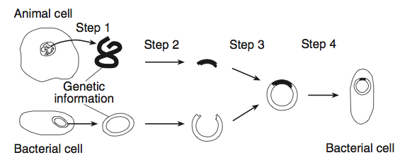
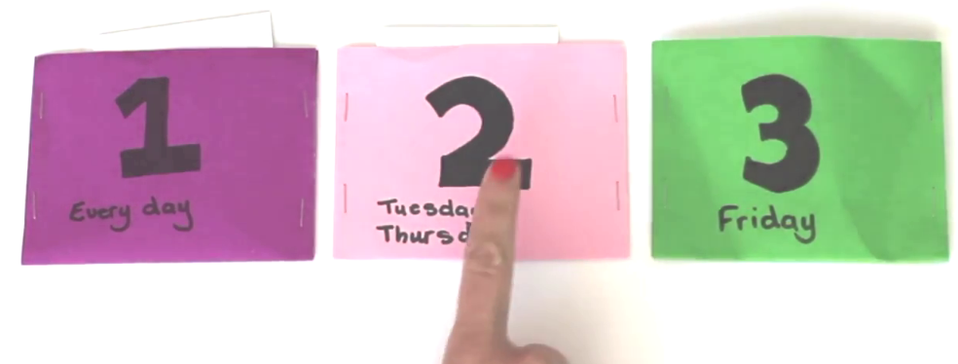
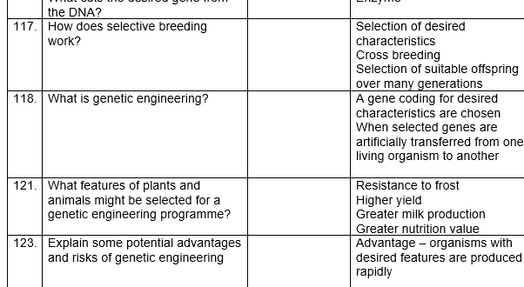
My advice to you about revision is 100% use past papers
Notes:
roan

Slide 19

Use the mark scheme
Method:
Attempt past paper questions – look for the ‘key words’ that get the marks
Why they work:
You get to know the paper inside out. Remember examiners are lazy and re-use questions.

Slide 20
Plan, review, re-do
Find a review time – avoid anything slipping by
Use mark schemes – you wouldn’t do your driving test without practise – see how your examiners mark
Repeat
Reward

Slide 21
“It always seems impossible until it is done.”

